Slide 1

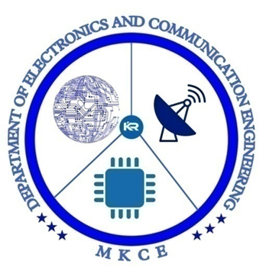

AN EFFICIENT SYSTEM FOR VISUALLY IMPAIRED BY USING LORA ra01
18ECP105L - Minor Project III
PRESENTED BY:
T.PAVITHRA (927621BEC144)

Slide 2
INTRODUCTION
Presently, blind people utilize a stick for bearings to move and walk.
Here, a new stick is developed to serve them with some valuable application and make it as user-friendly.
This technology makes walking stick smarter which has many applications together with taking walks to stick indicator in case if they miss the stick through a voice, they might walk utilizing the way of themselves.
If they face any obstacle, they can sense is by a ultrasonic sensor, and also they can hear the guide directions in the headset.

Slide 3
PROBLEM STATEMENT
A need for device, such as a stick, that can help people who are visually impaired in all parts of their lives because blind people are not often given aid.
The stick's effectiveness and affordability are its two primary requirements, for being beneficial to everyone who are all blind.
The blind individual is made aware of barriers when their phone vibrates or plays an audio message since it employs ultrasonic sensors to detect them.
Mobility and independence for visually impaired people refers to the ability to move confidently, quickly, and safely about their local environment independently, however it is not possible, without technology.

Slide 4
OBJECTIVES
To design and implement an efficient assistive system for visually impaired individuals using LoRa RA-01 technology, aimed at enhancing their mobility and accessibility by providing real-time navigation, obstacle detection, and communication capabilities.

Slide 5
EXISTING SYSTEM
IOT-BASED OBSTACLE DETECTION SYSTEM FOR VISUALLY IMPAIRED PERSON WITH SMARTPHONE MODULE
An IoT-based system that helps to detect obstacles and water puddles on their way.
The system consists of a walking stick and an Android app from a third-party app.
The walking stick is integrated with an ESP32 microcontroller, an ultrasound sensor, and an app for smartphones.
The sensors gather information from the surroundings, and the ESP32 microcontroller detects the obstacle by processing the information.

Slide 6
PROPOSED SYSTEM
Water sensors and ultrasonic sensors are used to detect impediments and the presence of water, respectively. With the help of these sensors, blind or visually challenged people who might have trouble navigating their surroundings can get crucial information.
This Using an MP3 module, the device uses a headphones to inform the user when it detects an obstruction or water. By knowing the position and characteristics of the obstacle or body of water, this warning can help the user avoid potential dangers.
The hardware device consists of PIC16F887 Microcontroller,Ultrasonic sensor,Watersensor, LI-ON Battery, LORA RA01 Transmitter and Receiver, Display,MP3 Audio playback module.

Slide 7
A set of speakers or headphones, a LORA RA01 module coupled to a microcontroller, can make up the wearable gadget.
The LORA RA01 can help the visually impaired navigate their environment. To accomplish this, the blind person can transmit and receive information using the LORA RA01 module.
As an example, "there is a coffee shop on your left" or "there is a park across the street" are examples of information on nearby landmarks or areas of interest.
By giving users real-time information about potential hazards, this system can help users navigate their surroundings with greater confidence and independence.

Slide 8
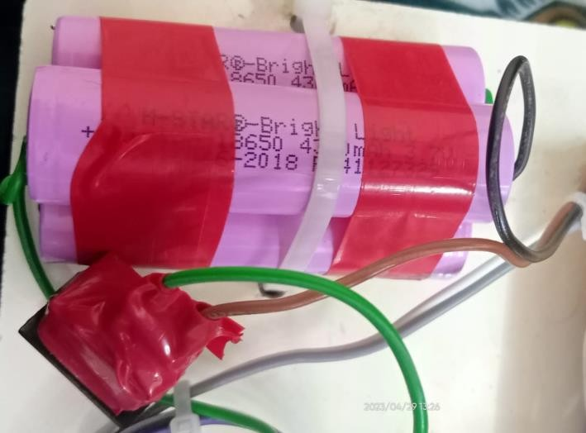
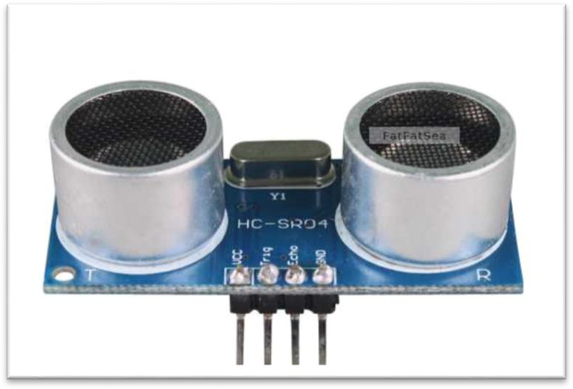
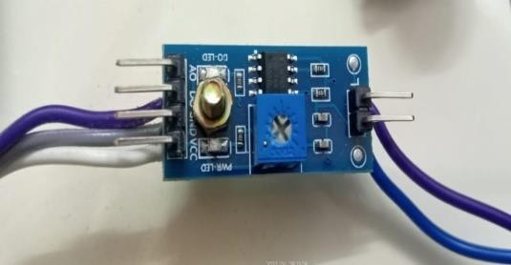
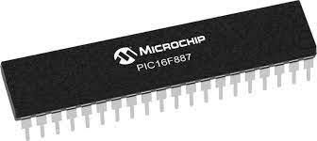
MODULE DESCRIPTION
HARDWARE REQUIREMENT
Ultrasonic Sensor
PIC16F887 Controller
Li-ion Battery
Loud Speaker
LCD Display
Water sensor
Button
LoRa Transceiver
MP3Audio Play Board Module
SOFTWARE REQUIREMENT
Embedded System
Arduino Platform

Slide 9
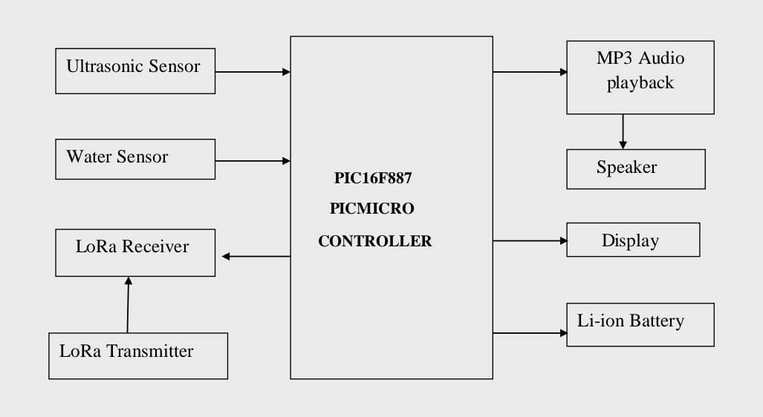
BLOCK DIAGRAM

Slide 10
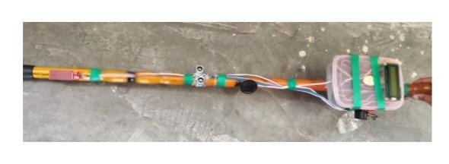
RESULT

Slide 11
CONCLUSION
In conclusion, a system that makes use of LoRa RA01 technology can offer effective assistance to those who are blind.
Long-range communication capabilities are made possible by the use of LoRa RA01, allowing for the real-time transmission of environmental data to the user.
The system may identify threats or barriers and alert the user through vibrations or aural cues by integrating sensors like ultrasonic sensors or webcams.
Additionally, the system may run for longer periods of time without needing frequent battery replacements because to LoRa technology's low power consumption.

Slide 12
REFERENCES
Vignesh N, Meghachandra Srinivas Reddy.P, Nirmal Raja.G,B.Sudhakar,Smart ShoeVisually Impaired Person, in International Journal of Engineering &Technology,July 2018.DOI:10.14419/ijet.v7i3.12.15890.
Nagpur Tyagi, Deepika Sharma, JaitegSingh,Bhisham Sharma, Assistive Navigation System for Visually Impaired and Blind People, in International Conference on Artificial Intelligence and Machine Vision (AIMV), 24-26 September 2021.DOI:10.1109/AIMV53313.20s21.9670951.
Tata Supriyadi, AdiraSalsabila, Ridwan Solihin, RifaHanifatunnisa, Budi Setiadi, SyifaAfni,Position Coordination Aid for Blind Persons Based on LoRAPoiny to Point, in 2nd International Seminar of Science and Applied Technology (ISSAT 2021).DOI:B/79.4/PL1.R7/PG.00.03/2021.

Slide 13


